Slide 1
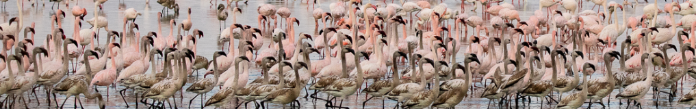




South Africa’s Biodiversity Data Pipeline for Wetlands and Waterbirds
Pachi Cervantes
SEEC Symposium 2022

Slide 2
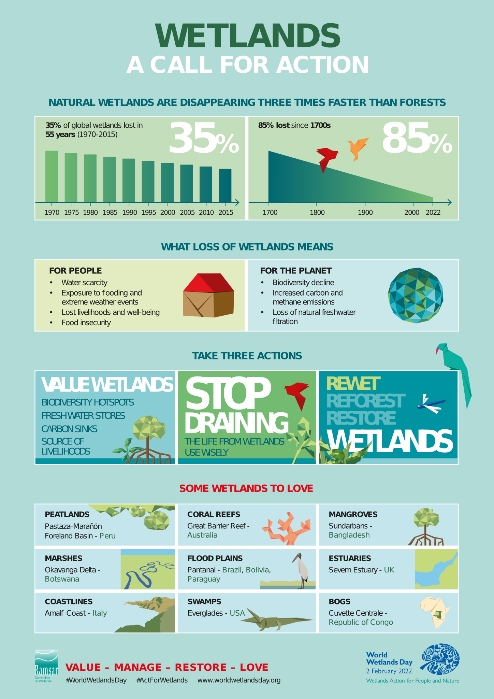
Introduction

Slide 3
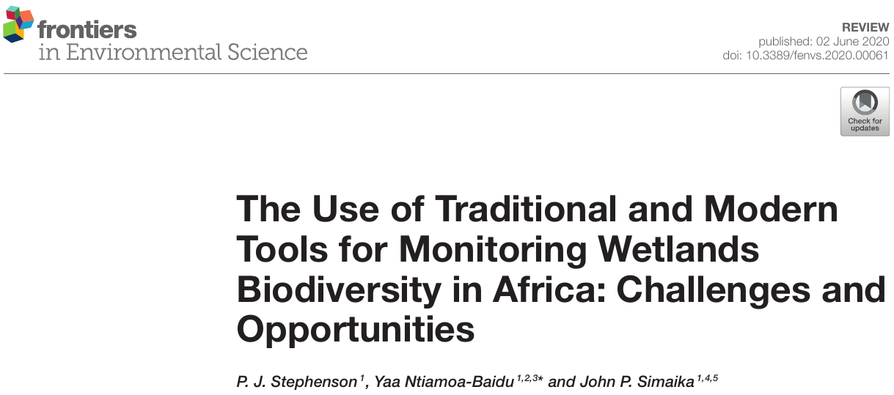
Introduction

Slide 4
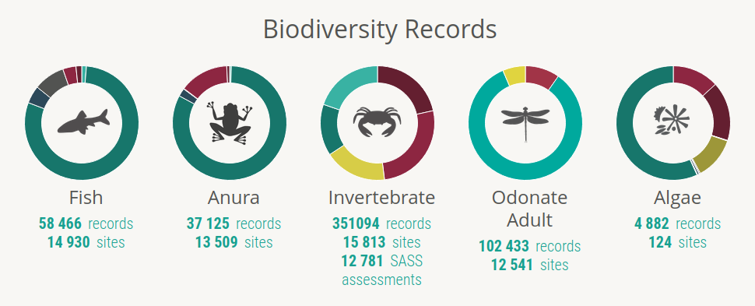
Introduction
FBIS:https://freshwaterbiodiversity.org/

Slide 5


Introduction
~ 347,000 records
739 sites
~ 17.6 million records
14061 pentads

Slide 6
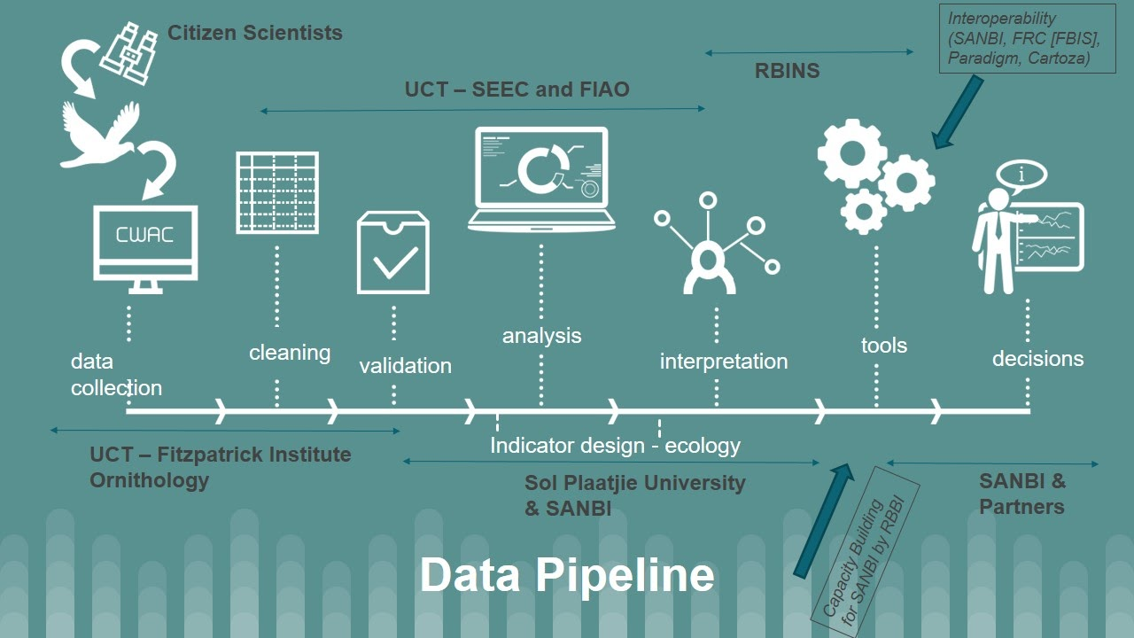
BIRDIE

Slide 7
Who is BIRDIE intended for?
International agreements: Ramsar, AEWA, ...
National programmes: National Biodiversity Assessments, Red Listing,...
Site-specific programmes
Researchers
General public: birders, naturalists, …
…
Notes:
Agreement on the Conservation of African-Eurasian Migratory Waterbirds

Slide 8


Indicators and data inputs
African Bird Atlas Project
Coordinated Waterbird Counts
Environmental data

Slide 9
Indicators and data inputs
African Bird Atlas Project
Distribution-related indicators
Occupancy
Area of occupancy
Extent of occurrence
…
Coordinated Waterbird Counts
Environmental data

Slide 10
Indicators and data inputs
African Bird Atlas Project
Coordinated Waterbird Counts
Abundance-related indicators
Abundance
Seasonal abundance
Abundance for guilds, sites, …
…
Environmental data

Slide 11
Indicators and data inputs
African Bird Atlas Project
Coordinated Waterbird Counts
Environmental data
Ancillary information
Weather data
Surface water
Wetland condition
…

Slide 12
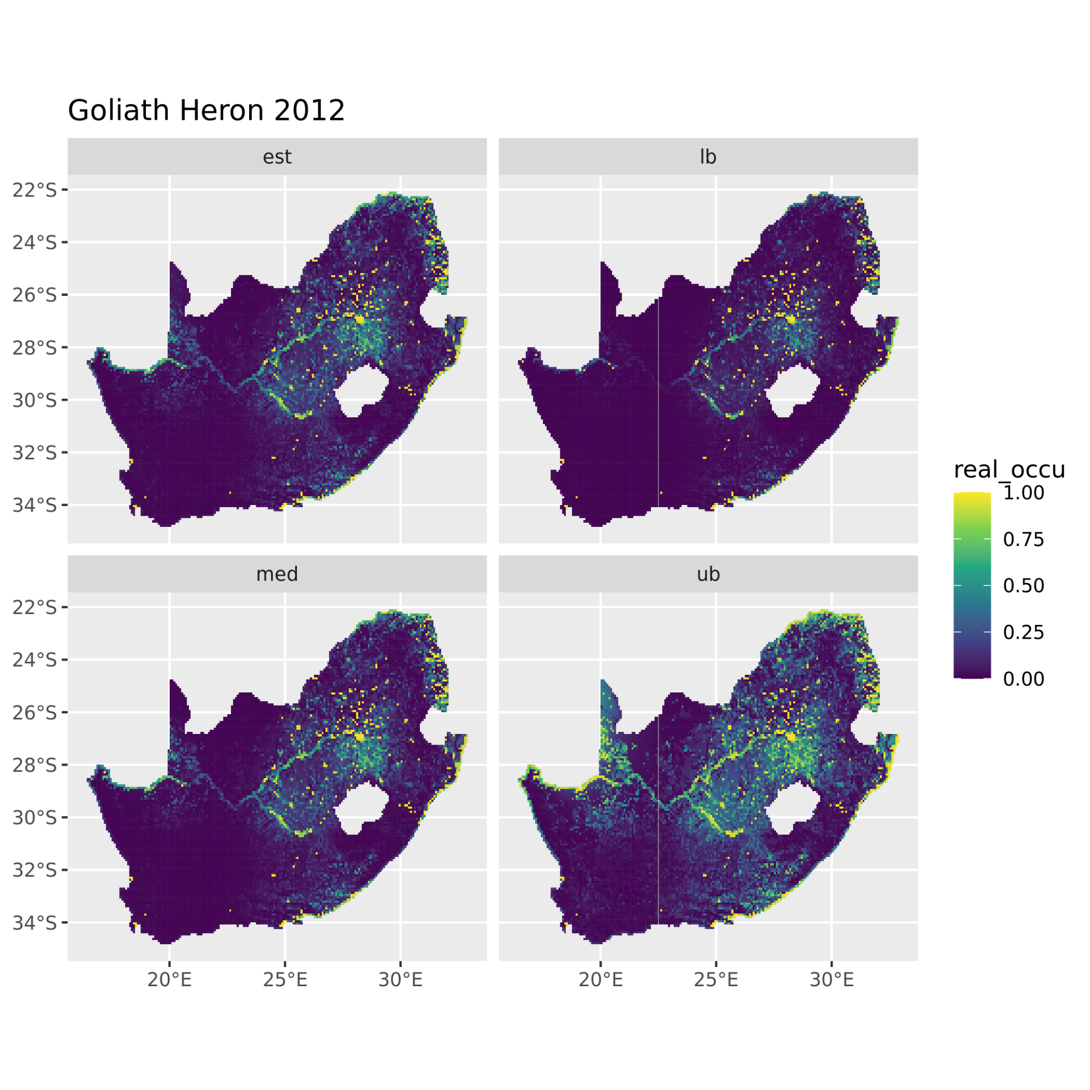
Species distribution
Occupancy models for ABAP
Spatio-temporal effects using splines (occuR package)
Moving three-year window

Slide 13
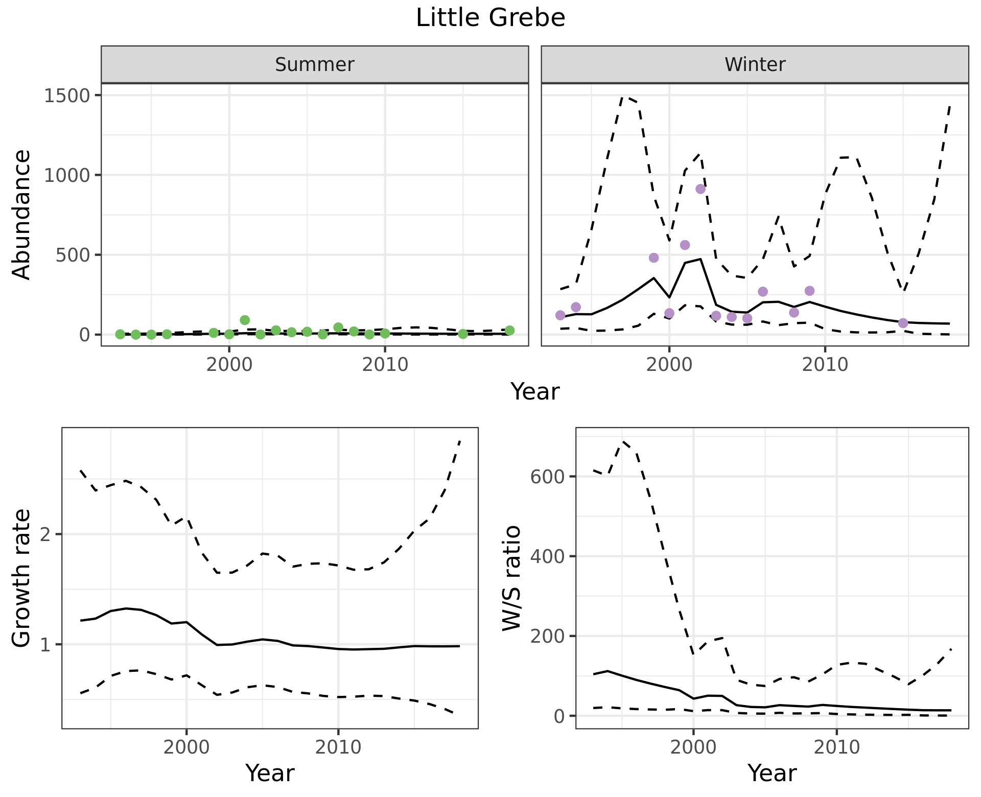
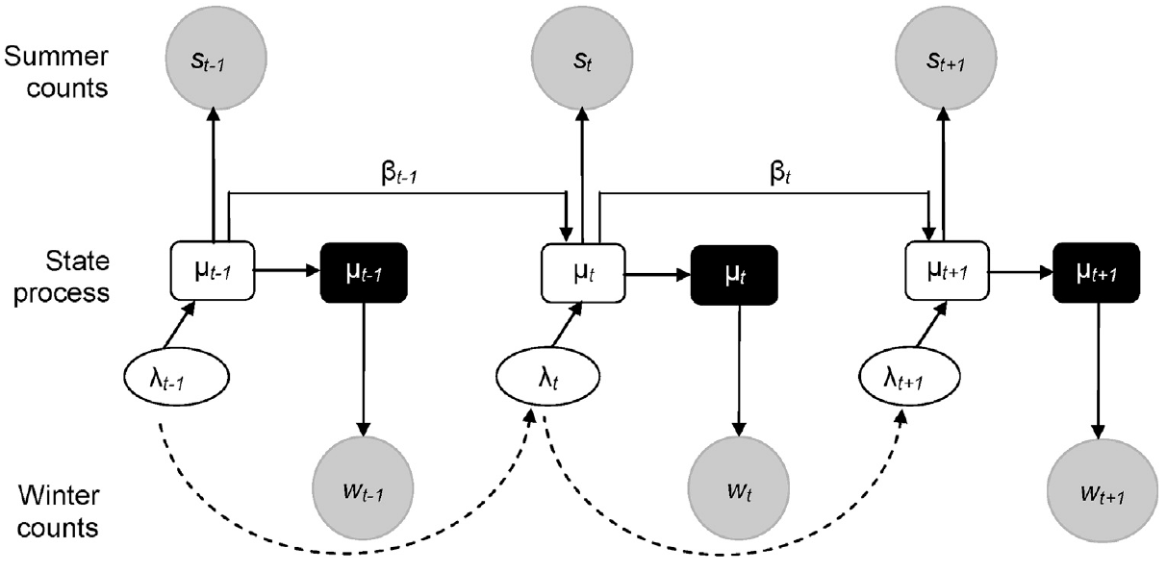
Species abundance
State-space model for CWAC
Species- and site- specific models
Aggregate results to obtain abundance at larger scales
Barshep et al. 2017, Global Eco. and Con. 12

Slide 14

Community diversity
Waterbird Conservation Value (Harebottle et al. 2016, Ostrich 87)
Living Planet Index (see Loh et al. 2005, Phi. Trans. Roy. Soc. 360)
Hill’s numbers (Hill 1973, Ecology 54)
…

Slide 15
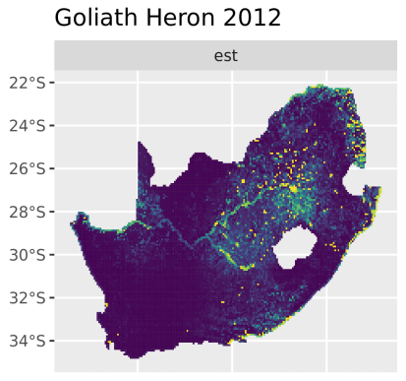
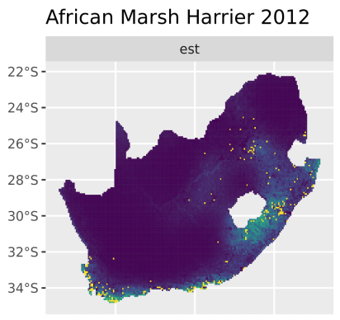
Progress and challenges
Challenges:
One model to fit them all

Slide 16
Progress and challenges
Challenges:
One model to fit them all
Running time
Occupancy: ~ 2.5 hours per species and year
Abundance: ~ 700 sites and ~200 species

Slide 17
Progress and challenges
Challenges:
One model to fit them all
Running time
Species with few detections
Large uncertainty
No convergence

Slide 18
Progress and challenges
Challenges:
One model to fit them all
Running time
Species with few detections
Irregular monitoring across sites
No convergence
Spurious abundance patterns due to sites monitored?

Slide 19

Thank you!

